Slide 1
Iconic Marks Across Borders: How Reputed and Famous Marks Are Treated in the United States
Melanye K. Johnson, Acting Deputy Chief Administrative Trademark Judge
Trademark Trial and Appeal Board (TTAB)
EUIPO IP Case Law Conference
Alicante, Spain
May 2026

Slide 2
Setting the Stage
The TTAB: Limited jurisdiction
Famous/Well-Known Marks in the USA:
Administrative Tribunal within the U.S. Patent and Trademark Office
Right to registration: TTAB considers only the right to registration, not the right to use
No related issues and cannot award damages or attorney fees, or issue injunctions, etc.
Main types of proceedings: Ex parte appeals of applications; inter partes trials (oppositions and cancellations).
The United States does not create, or consult, famous mark registries.
The United States does not create, or consult, well-known mark registries.
FAME MUST BE PROVEN — WITH SUBSTANTIAL EVIDENCE — IN EVERY SINGLE CASE.

Slide 3
I. LoC: The “Fame” Factor under Lanham Act § 2(d)
“The prior trademark’s level of recognition and fame.” (Factor #5)
In re E. I. du Pont de Nemours & Co., 476 F.2d 1357 (C.C.P.A. 1973)
Non-exhaustive list of factors to determine the FAME OF THE PRIOR MARK in Opposition and Cancellation proceedings:
Duration and extent of use of the mark
Duration and extent of sales and advertising of the mark
Extent of geographical trading area
Channels of trade
Degree of recognition of the mark in those channels of trade
Unsolicited publicity
Whether the mark is registered

Slide 4
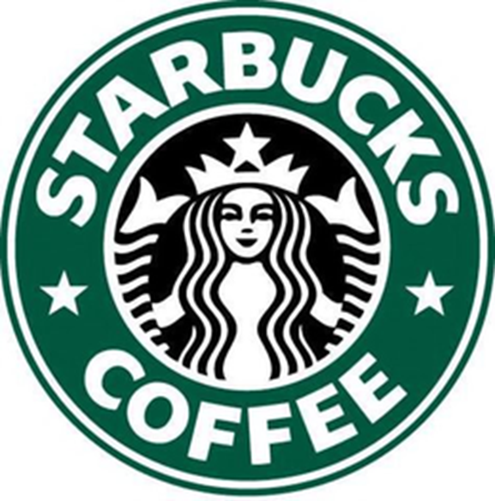
STARBUCKS COFFEE vs. "LESSBUCKS COFFEE"
Starbucks filed an opposition against Marshall Ruben’s application for LESSBUCKS COFFEE for coffee and retail store services.
The Board sustained the opposition, finding that STARBUCKS was a famous mark and accorded it a “broad scope of protection” under the fifth Du Pont factor.
2001-2004: $10 billion USD in sales and $150 million USD in marketing expenditures
5,000 company-owned and licensed stores in USA
11 million consumer transactions per week
350,000 "hits" per week at Starbucks website
2004: Nearly half of all US consumers had visited a Starbucks store.
Surveys
Starbucks U.S. Brands, LLC v. Ruben, 78 USPQ2d 1741 (TTAB 2006)

Slide 5
II. Dilution: 15 U.S.C. § 1125(c) (Lanham Act § 43(c))
Protects famous marks “widely recognized by the general consuming public” against dilution, impairing their distinctiveness.
The party alleging dilution must assert:
It owns a famous mark that is distinctive;
Applicants are using a mark in commerce that allegedly dilutes the party’s famous mark;
Applicant’s use of its mark began after the party’s mark became famous; and
Applicant’s use of its mark is likely to cause dilution by blurring.
Coach Servs. Inc. v. Triumph Learning LLC, 668 F.3d 1356, 101 USPQ2d 1713, 1723-24 (Fed. Cir. 2012).

Slide 6
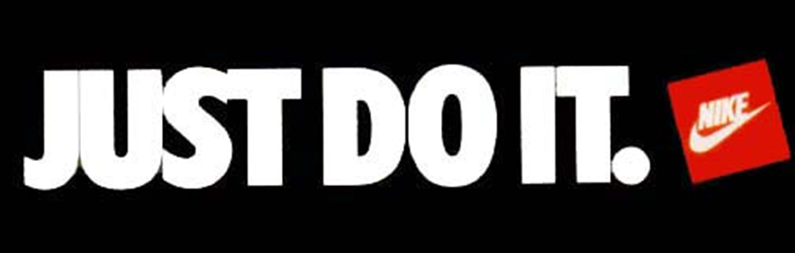
LoC & Dilution
Applicants applied for JUST JESU IT for a variety of clothing, including athletic apparel.
NIKE opposed based on JUST DO IT for clothing and other items; alleged LoC and dilution (by blurring).
Board: JUST DO IT is a household mark.
Enjoys the highest level of fame (a/k/a “dilution fame”).
Became famous long before applicants applied for their mark.
Similar evidence presented as in other Nike oppositions.
Opposition sustained; registration refused; dilution found.
Nike, Inc. v. Peter Maher and Patricia Hoyt Maher, 100 U.S.P.Q.2d 1018 (TTAB 2011) (precedential)
Applicants applied for JUST DREW IT! for athletic clothing.
NIKE opposed based on JUST DO IT for clothing and other items; alleged LoC and dilution (by blurring).
Board: JUST DO IT is a household mark.
Enjoys the highest level of fame (a/k/a “dilution fame”).
Became famous long before applicants applied for their mark.
Similar evidence presented as in other Nike oppositions.
Opposition sustained; registration refused; dilution found.
Nike v. Caldwell, 2020 Westlaw 3027610 (TTAB 2020) (nonprecedential).

Slide 7
Evidence: “JUST DO IT” vs. “JUST DREW IT!”
Runner up in AdAge magazine’s “Top 10 Slogans” of the 20th century
“One of the most famous and easily recognized slogans in advertising history”
“A third-party survey asked 1,000 respondents which company uses the “advertising slogan ‘Just Do It’,” and 79% correctly identified Nike.
JUST DO IT ads have featured, among many others, Michael Jordan, Tiger Woods, LeBron James, and Serena Williams
Social Media followers: Facebook, 32 million; Twitter, 7 million; Instagram, 85 million
1989-2020: Approximately $200 million spent advertising the JUST DO IT mark in the United States
Previous finding of famousness by the Board on a similar record of fame.
Public perception
“Nike's ‘Just Do It’ slogan … might be the last great tagline in advertising history.”
“
“This evidence establishes that JUST DO IT is not only famous for purposes of both of Opposer's claims, but exceedingly so. It is entitled to the highest level of protection against confusion.”
*Similar evidence presented in “Just Do It” vs. “Just Jesu It” opposition.

